Slide 1
PORTFOLIO PLAN & ENTERPRISE ARCHITECTURE AGENDA 2023
407 bio
IT Planning & Architecture
200++initiatives
100++
Architecture & Capability Changes
15+
9+
50+
350++
Consolidation
Enhancement
New Capability
Applications

Slide 2
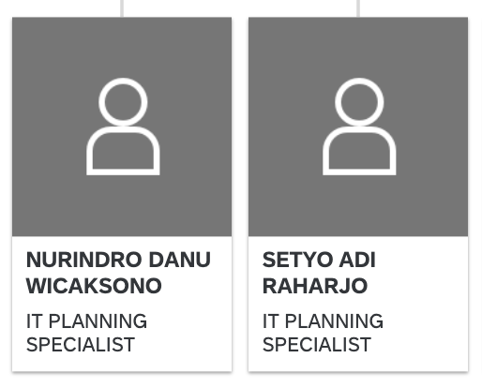




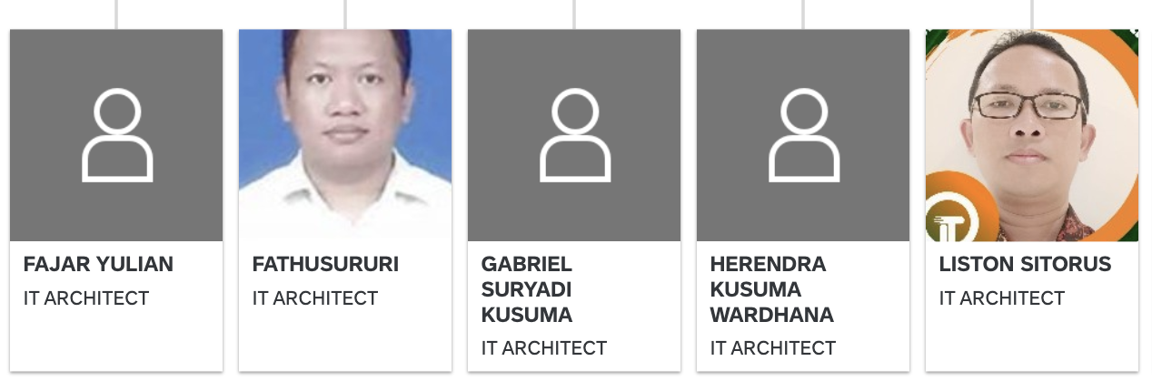
THE TEAM
Strategy & Planning
(RSTI, RPTI, SCM, Budgeting, OpModel)
Portfolio Management
App, Tech, EUC, Cloud
Bank-wide Architecture alignment (SAF)
Solution Architect (SF)

Slide 3
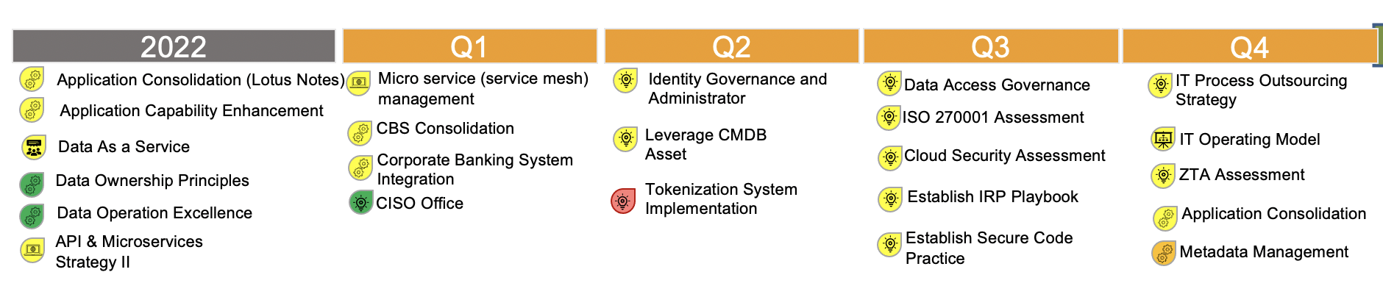
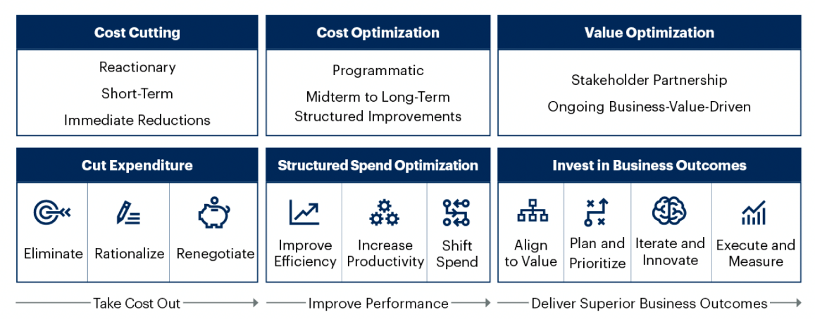
IT Strategic Plan 2022 - 2026
3 initiatives have been successfully implemented , and 1 initiative has been dropped.
The transfer knowledge between CISO and IT Team will be gradually handed over and effective per July 1 st, 2023 the CISO Team will continue to execute the Cyber Security Roadmap.
Strategic Cost Management 2023-2025
8.167 mio
8.948 mio
Cost Saving Achieved
Cost Avoidance Achieved
40 app
105 server
In progress decommissioning

Slide 4
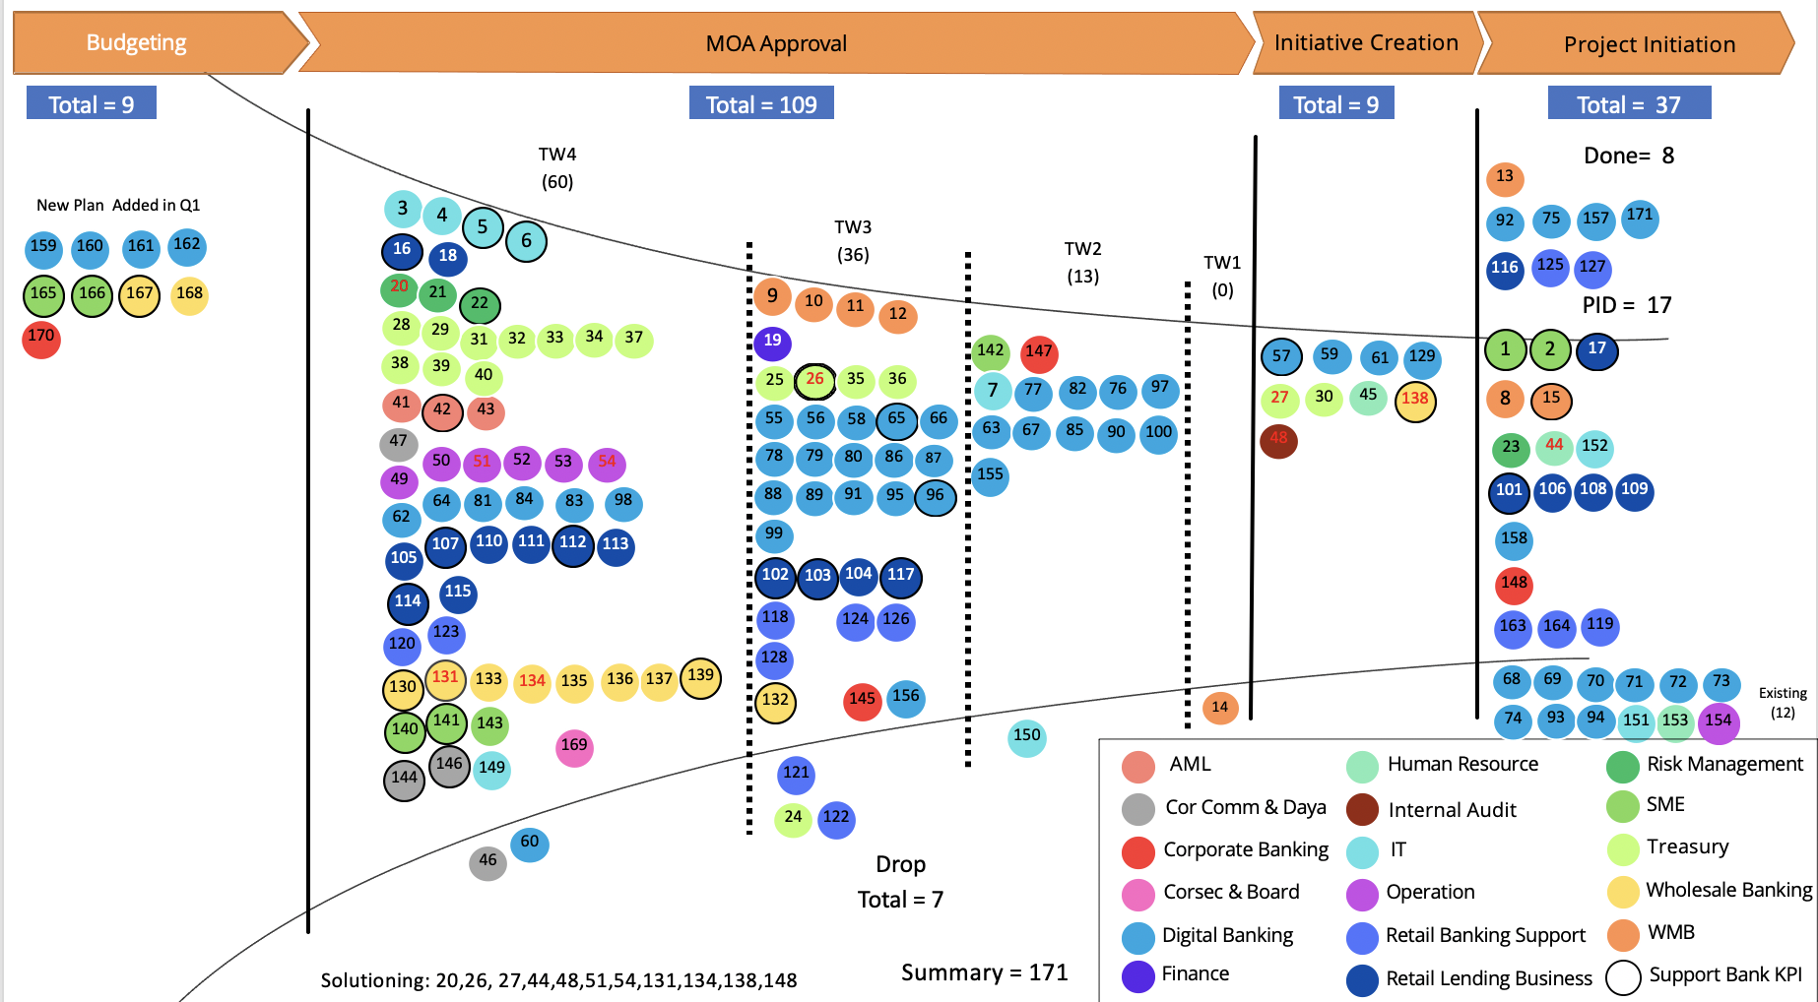
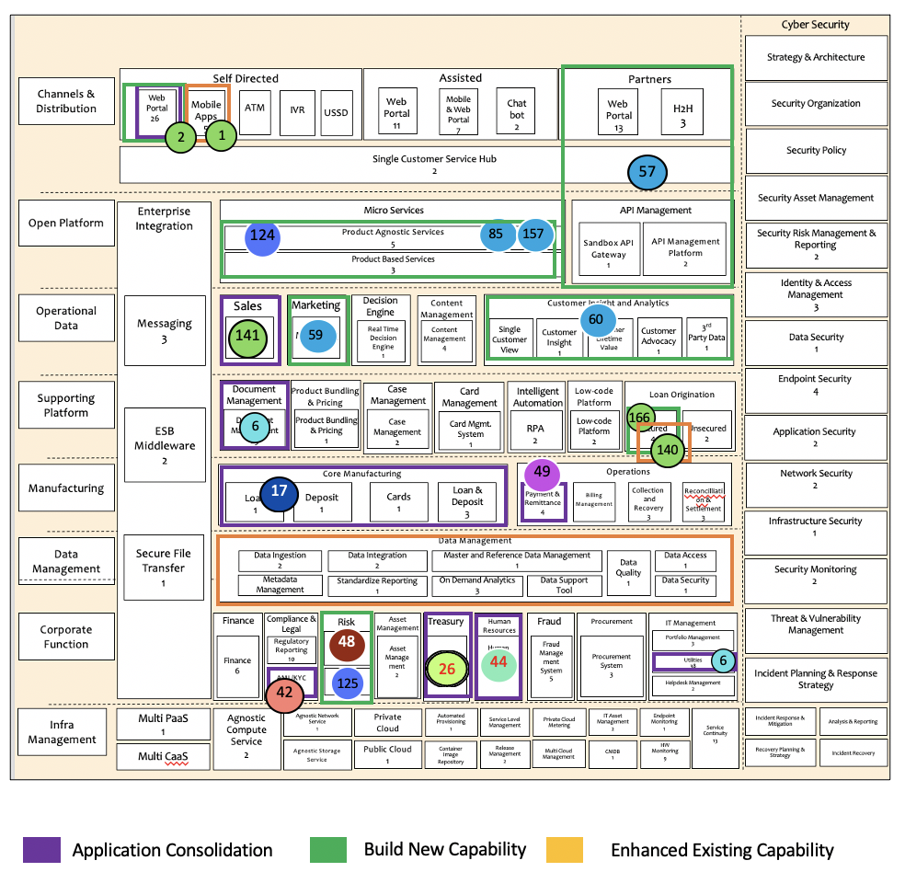
Portfolio Plan Dashboard
EA Capability Dashboard
Gives a sense of how far the bank’s plans are executed and how much the investment realized.
Tracking the status of IT & business plan listed in RPTI - officially will be revise & report in Quarterly to OJK.
Gives a sense of how the enterprise capability landscape is changing (consolidate, new, enhanced)
Bring visibility of architecture changes for enterprises purposes.
Ensure all capabilities built and architectural changes are aligned with IT & business plans, goals, and priorities

Slide 5

Initiative execution process
Budgeting
MOA Approval
Initiative creation
Project initiation
Planned project that approved in annual budget can directly go to MOA approval
For unplan project need to do reallocation of budget from within/ cross lob/sf
MOA Approval process are adhering to finance policy
Passing Condition:
Unplan project have budget sources defined
Passing Condition:
Benefit are clearly articulated (i.e revenue projection, cost saving)
Cost estimate are validated with sound assumption
Investment can be justified with the projected benefit
Passing Condition:
Requirement are defined and agreed in BRD
Solution component is identified and HLD of the Solution are agreed
Passing Condition:
Timeline, scope, and budget of project defined
Team project defined.
Document’s approval is according to approval matrix / roles and responsibilities.
Estimated duration:
1-8 weeks.
Estimated duration:
<3 Months * due to moa expiration policy
Estimated duration:
~1 week
Budget name
Plan Live -- Estimate duration
Aging
Low Risk
= on schedule
= critical to meet expected timeline
= high probability to exceed timeline
UP = Unplanned Initiatives
KI = Key initiatives that directly support bank KPI
UP
KI
Medium Risk
High Risk

Slide 6
























































Budgeting
MOA Approval
Initiative Creation
Budgeting
Initiative Creation
Project Initiation
Total = 8
Total = 106
Total = 9
Total = 40
TW4
(58)
Done= 8
New Plan Added in Q1
13
3
4
5
92
75
157
171
162
6
TW3
(36)
159
160
161
16
18
TW2
(13)
TW1
(0)
125
20
116
127
170
166
167
168
21
22
9
10
11
PID = 20
28
29
12
31
32
33
34
37
19
142
147
57
59
129
1
2
17
38
39
40
26
35
36
61
25
7
77
82
76
97
27
30
45
138
8
15
132
MOA Approval under radar 99 Billion out of 407 Billion annual budget.
41
42
43
55
56
58
65
66
134
131
47
63
67
85
90
100
48
23
44
152
50
51
52
53
54
78
79
80
86
87
155
49
88
89
91
95
96
101
106
108
109
62
64
81
84
83
98
107
110
111
112
113
99
158
105
102
103
104
117
114
115
148
123
118
124
126
163
164
119
120
128
130
133
135
136
137
139
68
69
70
71
72
73
145
156
14
Existing
(12)
140
141
143
150
165
74
93
94
151
153
154
146
169
AML
Human Resource
Risk Management
144
149
121
24
122
Cor Comm & Daya
Internal Audit
SME
46
60
Drop
Total = 8
Corporate Banking
IT
Treasury
Corsec & Board
Operation
Wholesale Banking
Digital Banking
Retail Banking Support
WMB
Solutioning: 20,26, 27,44,48,51,54,131,134,138,148
Summary = 171
Finance
Retail Lending Business
Support Bank KPI

Slide 7
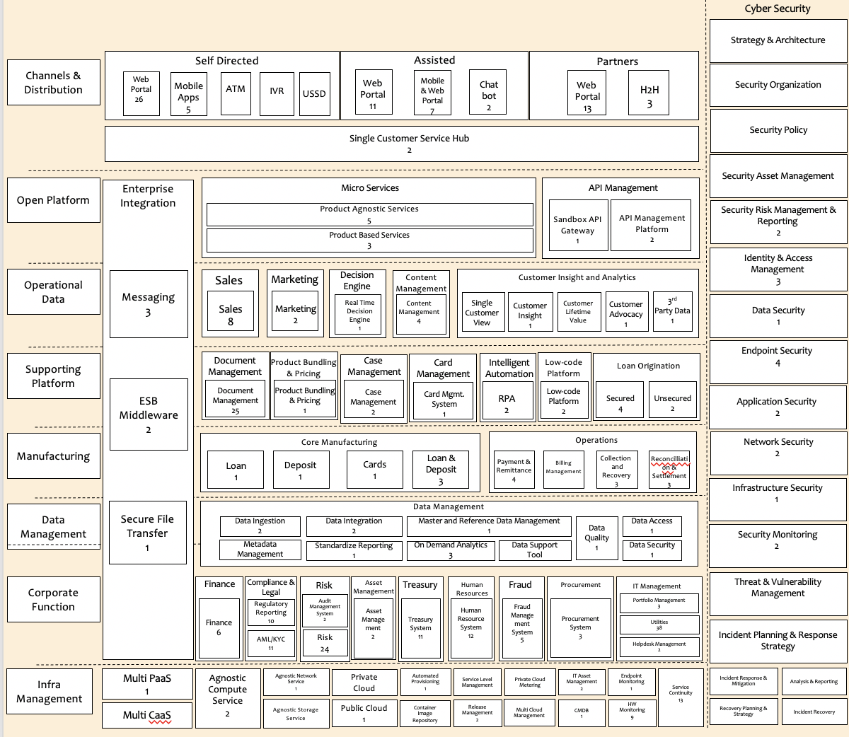

Summary of Enterprise Architecture Agenda 2023 (1/3)
Application Consolidation (1/1)
id | Initiatives | Status
 | AML system consolidation | Assessment
 | Treasury System Consolidation – OPICS Termination | Cancelled
 | Core Banking Consolidation Join Finance Multi finance Consolidation (JFAST, JOFIS, EQ) CBS Phase 2 (Loan IQ, BES ) WOW sunset | Project Solutioning Decommission
 | HR Transformation HC System Consolidation – Darwinbox | Project
 | Sales Planning Tools Consolidation – (Emejaku CRM 365) | Assessment
 | New Integrated Payment System (FIRST, BIFAST, BES, MS Payment) | Assessment
 | Document management consolidation | Procurement
 | IT Utilities (digital tools, monitoring, telephony system) | Assessment
 | Web Portal consolidation (portal kita) | Completed
26
42
2
1
65
57
17
124
85
157
44
141
141
59
60
49
6
6
166
140
49
17
New Capability (1/2)
id | Initiatives | Status
 | BaaS (Bank as a Service) | Initiation
 | Jenius as a platform | Initiation
 | Marketing Automation System (Moengage cloud) | Initiation
 | Face Recognition with liveness (verification for link new devices) | Completed
 | Face Recognition for KYC Dukcapil (PrivyID cloud) | Completed
 | Customer Data Platform | TBC
 | Cardless card withdrawal | Assessment
57
65
20
48
6
59
26
125
42
44
85
157
60
159
Application Consolidation
Build New Capability
Enhanced Existing Capability

Slide 8
Summary of Enterprise Architecture Agenda 2023 (2/3)
New Capability (2/2)
id | Initiatives | Status
 | Cash Pick Up Management | Completed
 | Video Call Services (Retail Banking Verification & KYC) | Project
 | Grading System of Business Banking | MOA Approved
 | SME Straight Through Loan Onboarding | Assessment
 | Digital SME Web (internet Banking) | Project
 | BI SNAP - HSM Chipper Trust | Requirement
 | New Audit Management System | Solutioning
20 | Financial Risk Analytic Framework | Solutioning
30 | Global liquidity engine (GLE) | Requirement
112 | Digitalization MAXI Micro | Requirement
131 | Custodian services – wholesale banking | Solutioning
144 | ESG System | Requirement
145 | Automated credit control system for corporate customer | Requirement
x | Fund Transfer Pricing System | Requirement
 | Digitalization of Register Book | project
 | Credit Control System for Corporate | Requirement
125
124
2
1
138
65
57
166
2
124
85
157
5
48
59
60
20
141
30
112
6
166
131
140
144
49
17
5
145
148
145
20
48
6
44
26
125
42
Application Consolidation
Build New Capability
Enhanced Existing Capability

Slide 9
Summary of Enterprise Architecture Agenda 2023 (3/3)
Enhance Existing Capability (1/1)
id | Initiatives | Status
 | Digital SME Mobile App - TOUCHBIZ | Project
 | Secured LOS & Bank Statement Analyzer | Requirement
x | Data Lake Refreshment - CDP Installation & Implementation at DR | Project
3 | MDM & RDM – Resolve customer golden data attribute | Solutioning
50 | BES, FES, Commandos, UIMS (Digitization OTC, Queuing System with face recog in FES ) | Project
24 25 26 27 29 | FOX, OBS, TIS, SWIFT Government bond Repo / reverse repo FX and call spread option Overnight index swap Treasury Repository | Requirement definition and solutioning
37 | FOX Renewal software & hardware | Requirement
38 | OBS Infra replacement | Requirement
12 | CRM 365 : Wealth Management Business | Requirement
8 | Wealth Management System – MVP2 | Requirement
16 | JOFIS 2023 | Requirement
21 | Basel 3 Revamp (LCR and NSFR) | Requirement
139 | Trade Finance System Phase 2 : FE System for trade & Supply Chain | Solutioning
101 102 103 | AROA-RACE (AROA Phase 2) Acquisition Process for B2C Acquisition Process for B2B Assisted channel for pension loan onboarding Data Processing for transaction & pre approve | Requirement & Solutioning
 | OPIC Enhancement | TBC
1
140
1
3
50
24
25
12
8
26
27
29
103
102
101
105
37
140
16
38
50
12
8
3
16
21
21
24
139
25
139
26
37
27
101
38
29
102
103
105
Application Consolidation
Build New Capability
Enhanced Existing Capability

Slide 10
Appendix List of Initiative per LOB

Slide 11
MOA approval status
LOB | MOA title | Full approved | Amount
Wholesale | Open API Phase 2 – SNAP | Y | 225
Wholesale | Custodian | Y | 4.500
IT | Infrastructure – Datacenter: Konversi Tape Backup DC1 | Y | 2.200
IT | Improvement – Voice & Telephony: Avaya to Ms.Teams (desktop phone replacement, allowing incoming outgoing call from-to Ms.teams. WFH purposes) | Y | 1.750
IT | Tech Refresh – Network: MDS Switch DC - For Switch Controller Storage | Y | 1.500
IT | Refreshment F5 Appliance & Support | N | 15.000
RLB | AROA phase 2 | N | 14.547
IT | Project Tech Refresh - Network – Core-Edge Router | N | 11.000
IT | Project CDP Installation & Implementation at Data Lake DR | N | 7.100
Internal Audit | Project New Audit Management System | N | 4.265
Operation | RPA 2023 | N | 3.840
Operation | Enhancement Surrounding Apps to CTAS from Dirjen Pajak | N | 2.208
Operation | Enhancement Surrounding Apps to Support eMeterai | N | 1.849
Operation | Enhancement OASIS | N | 1.104
Finance | Persetujuan Perpindahan Budget IT Capex internal Finance dan Pengadaan Laptop untuk new joiner | Y | 55
Compliance | Pengajuan Pembelian Laptop untuk Head Compliance | Y | 26
HR | HR More Than A Job | Y | 100
Ops | Budget Project ORR di 2023 | Y | 10.560
Wholesale | Grading System | Y | 13.000
Internal Audit | New AMS System | Y | 4.265

Slide 12
Information Technology
Budgeting
MOA Approval
Initiative creation
Project initiation
5 BI SNAP - HSM Chipper Trust
Q4 2023 – 9 months
Aging 3 month
152 Email auto encryption (cloud)
Q4 2023 – 9 months
Aging 3 month
KI
6 Application Consolidation
Q4 2023 – 9 months
Aging 3 month
KI
3 Audit Finding - Resolve customer golden data attribute for regulatory report in MDM and RDM Q4 2023 – 9 months
Aging 3 month
4 OJK Audit Finding - System to revamp Audit trail process of PPD (Permintaan Perubahan Data) Q4 2023 – 9 months
Aging 3 month
7 Identity Governance and Administrator - CYBS Roadmap Q2 2023 – 3 months
Aging 3 month
149 ITSP Metadata
Q4 2023 – 9 months
Aging 3 month
1 existing initiative is excluded
1 dropped initiative is excluded

Slide 13
Digital Banking
Budgeting
MOA Approval
Initiative creation
Project initiation
157 PrivyID (Cloud) for Face
Recognition Q1 2023– 3 months
Aging 0 months
65 Jenius as a Platform to Retail
Q3 2023– 6 months
Aging 3 months
57 BaaS (Bank as a Service)
Q3 2023 – 6 months
Aging 3 month
Done
KI
KI
171 Digital Market Update
Q1 2023– 3 months
Aging 0 months
Tarik tunai tanpa kartu (Cardless withdrawal)
Q3 2023– 6 months
Aging 0 months
96 Back-to-Back Loan
Q3 2023– 6 months
Aging 3 months
59 J3.0 Marketing Automation System
Q3 2023– 6 months
Aging 3 months
Done
UP
KI
UP
75 Ali Cloud (Cloud)
Q1 2023– 3 months
Aging 0 months
55 Fitur Gamification Reward
Q3 2023– 6 months
Aging 3 month
61 Asset Repository for All Marketing and UIUX
Q3 2023– 9 months
Aging 3 months
Done
Pengembangan fitur jual/beli dan transfer mata uang asing dengan waktu operasional 24 jam sehari, 7 hari seminggu.
Q3 2023– 6 months
Aging 0 months
92 WhatsApp 2 Way Com
Q1 2023– 3 months
Aging 0 months
56 Fitur Loyalty Reward
Q3 2023 – 9 months
Aging 3 months
Done
UP
129 Jenius Credit Card Core System
Q3 2023– 6 months
Aging 3 months
Seciron (Cloud)
Q3 2023– 6 months
Aging 0 months
New Risk Profiles
Q3 2023 – 6 months
Aging 3 month
58 Remittance STP
Q3 2023– 6 months
Aging 3 months
UP
KI
Credit Shield
Q3 2023– 6 months
Aging 0 months
100 Credit Card - Merchant Installment Automation Q2 2023– 3 months
Aging 3 months
UP
Security-Face Recognition (Cloud) KYC Q2 2023– 3 months
Aging 0 months
155 Penambahan Jenis sumber dana untuk transaksi melalui QRIS
Q2 2023– 3 months
Aging 3 months
UP
85 Security-Face Recognition (Cloud) link device
Q3 2023 – 6 months
Aging 0 months
156 Perx
Q3 2023– 6 months
Aging 3 month
10 existing initiative are excluded
1 dropped initiative are excluded

Slide 14
Digital Banking-2
Budgeting
MOA Approval
Initiative creation
Project initiation
62 Co Branding Card-Credit Card Enhancement Q4 2023 – 9 months
Aging 3 month
63 Alternative Credit Scoring & OS
Q2 2023– 3 months
Aging 3 months
64 NFC wallet
Q4 2023– 9 months
Aging 3 months
66 Migrate Jenius E Form into BTPN Unified E-Form Q3 2023– 6 months
Aging 3 months
76 QR TTS
Q2 2023– 3 months
Aging 3 month
77 QR Cross Border
Q2 2023 – 3 months
Aging 3 months
78 QR Kartu Kredit
Q2 2023– 3 months
Aging 3 months
79 Investment Obligasi Pasar Perdana
Q3 2023– 6 months
Aging 3 months

Slide 15
Digital Banking-3
Budgeting
MOA Approval
Initiative creation
Project initiation
80 InvestmentObligasi Pasar Sekunder
Q2 2023 – 9 months
Aging 3 month
81 Investment Bancassurance
Q2 2023– 3 months
Aging 3 months
82 Menambah layanan pembayaran mitra strategis Q2 2023– 3 months
Aging 3 months
83 layanan pembayaran bekerja sama dengan PJSP dan/atau PJPP
Q2 2023– 3 months
Aging 3 months
84 memperkaya fitur dan kapabilitas aplikasi Jenius dengan bekerja sama dengan perusahaan fintech.
Q2 2023– 3 months
Aging 3 month
86 Flexicash merchant ecommerce
Q2 2023– 3 months
Aging 3 months
87 Flexicash tokoscore
Q2 2023– 3 months
Aging 3 months
88 Flexicash Kerjasama mitra
Q3 2023– 6 months
Aging 3 months

Slide 16
Digital Banking-4
Budgeting
MOA Approval
Initiative creation
Project initiation
89 Flexicash PCCM
Q3 2023 – 6 months
Aging 3 month
90 Moneytory : Budgeting and AI (SB & Billers) Q2 2023– 3 months
Aging 3 months
91 Jenius Billers & VISA Tokenization
Q3 2023– 6 months
Aging 3 months
95 Mutual Fund Switching
Q3 2023 – 6 months
Aging 3 months
97 Sinaya Gift Migration to Jenius Reward Q3 2023– 6 months
Aging 3 months
98 Transaction Authorization via Jenius
Q4 2023– 9 months
Aging 3 months
67 Cloud figma
Q2 2023– 3 months
Aging 3 months
75 Chatbot (Cloud Lokal)
Q2 2023– 3 months
Aging 3 months

Slide 17
WMB
Budgeting
MOA Approval
Initiative creation
Project initiation
9 Server for WMB Datamaart
Q4 2023– 9 months
Aging 3 months
13 Sinaya Gift
Q1 2023– 3 months
Aging 0 months
Done
10 WMB LKR Enhancement
Q3 2023 – 9 months
Aging 3 months
8 New Wealth Management Core System (DFS)- MVP 2 Q4 2023– 9 months
Aging 3 months
11 ROBO Enhancement
Q3 2023 – 6 months
Aging 3 months
15 Simplify Sinaya Saving Account
Q2 2023 – 3 months
Aging 3 month
12 CRM Enhancement
Q4 2023– 9 months
Aging 3 months
KI
* 1 dropped initiative is excluded

Slide 18
RLB – Retail lending, Consumer Finance
Budgeting
MOA Approval
Initiative creation
Project initiation
102 Acquisition Process for B2B (business to Business) Q3 2023– 6 months
Aging 3 months
101 Acquisition Process for B2C (business to Customer) Q2 2023 – 3 months
Aging 3 month
KI
KI
103 Onboarding process Loan
For Pension Q3 2023– 6 months
Aging 3 months
106 Installment
Q2 2023 – 3 months
Aging 3 months
KI
107 E2E Retail Process - Pension Payment Integrated Q4 2023 – 9 months
Aging 3 months
108 Receivables transfer on the financing for Lending Business Management
Q2 2023 – 6 months
Aging 3 months
KI
104 Insurance for all partner
Q3 2023 – 6 months
Aging 3 months
109 Data Flagging Loan (Taspen & Asabri)
Q2 2023 – 6 months
Aging 3 months
105 Data Processing for transaction & pre approve
Q4 2023– 9 months
Aging 3 months
JFAST
Q4 2023– 9 months
Aging 3 months
JOFIS 2023
Q4 2023 – 9 months
Aging 3 month
KI
KI
RPIM automation for reporting-Consumer Finance
Q4 2023– 9 months
Aging 3 months

Slide 19
RLB – Micro business
Budgeting
MOA Approval
Initiative creation
Project initiation
112 Digitalization MAXI Micro
Q4 2023 – 9 months
Aging 3 month
116 Damai Android Upgrade
Q1 2023– 3 months
Aging 0 months
Done
KI
114 Digital Micro Business Community Hub Q4 2023– 9 months
Aging 3 months
KI
117 Digital Micro Enhance phase II
Q3 2023– 6 months
Aging 3 months
KI
110 Digital Micro Product Code
Q4 2023 – 9 months
Aging 3 months
111 Enhancement KUR Application System Q4 2023 – 9 months
Aging 3 months
115 Take Out NginX
Q4 2023– 9 months
Aging 3 months
113 Sales Activity Monitoring System
Q4 2023– 9 months
Aging 3 months

Slide 20
Retail Banking Support - RBR
Budgeting
MOA Approval
Initiative creation
Project initiation
120 Cash Pick Up - Phase 2
Q3 2023– 6 months
Aging 3 months
163 Voice Notification
Q4 2023– 9 months
Aging 3 months
Done
164 FDS (Fraud Detection System)
Q4 2023– 9 months
Aging 3 months
123 Regla PSAK 71 & Antasena for CC and Digital Micro
Q4 2023 – 9 months
Aging 3 months
Done
125 Cash Pick Up Management
Q1 2023– 6 months
Aging 3 months
Done
124 Video Call Verification
Q4 2023 – 9 months
Aging 3 months
127 TFMS: Machine Learning
Q4 2023– 9 months
Aging 3 months
Done
128 TFMS: Device Learning
Q4 2023– 9 months
Aging 3 months
126 EFS –Penurunan data ke PSAK
Q3 2023– 6 months
Aging 3 months
119 CTI & Recording (Predictive Call)
Q3 2023– 6 months
Aging 3 months
118 EFS
Q4 2023 – 9 months
Aging 3 month
* 2 dropped initiative are excluded

Slide 21
Retail Banking Support - RBR
Budgeting
MOA Approval
Initiative creation
Project initiation
120 Cash Pick Up - Phase 2
Q3 2023– 6 months
Aging 3 months
163 Voice Notification
Q4 2023– 9 months
Aging 3 months
Done
164 FDS (Fraud Detection System)
Q4 2023– 9 months
Aging 3 months
123 Regla PSAK 71 & Antasena for CC and Digital Micro
Q4 2023 – 9 months
Aging 3 months
Done
125 Cash Pick Up Management
Q1 2023– 6 months
Aging 3 months
Done
124 Video Call Verification
Q4 2023 – 9 months
Aging 3 months
127 TFMS: Machine Learning
Q4 2023– 9 months
Aging 3 months
Done
128 TFMS: Device Learning
Q4 2023– 9 months
Aging 3 months
126 EFS –Penurunan data ke PSAK
Q3 2023– 6 months
Aging 3 months
119 CTI & Recording (Predictive Call)
Q3 2023– 6 months
Aging 3 months
118 EFS
Q4 2023 – 9 months
Aging 3 month
* 2 dropped initiative are excluded

Slide 22
SME
Budgeting
MOA Approval
Initiative creation
Project initiation
166 SME Straight Through Loan Onboarding
Q3 2023– 6 months
Aging 0 months
140 Secured loan origination (include LOS & Bank Statement Analyzer / BSA)
Q4 2023– 6 months
Aging 3 months
1 Digital SME Phase 1
Q2 2023 – 9 months
Aging 0 month
UP
KI
KI
KI
141 Emejaku
Q4 2023 – 9 months
Aging 3 months
2 Digital SME Phase 2
Q3 2023– 9 months
Aging 0 months
KI
KI
*currently using 2022 budget
142 Tools for partial migration Equation
Q2 2023 – 3 months
Aging 3 months
143 RPIM automation for reporting-SME
Q4 2023– 9 months
Aging 3 months
165 Loan Valas SME (drop)
Q3 2023 – 6 months
Aging 0 months
UP
KI

Slide 23
Wholesale Banking Group
Budgeting
MOA Approval
Initiative creation
Project initiation
167 Migrate Customer commercial
Q3 2023– 6 months
Aging 0 months
130 Corp Bond Investment
Q4 2023– 9 months
Aging 3 months
138 Grading System for Commercial Banking
Q4 2023 – 9 months
Aging 3 months
134 Trade Finance phase 2 (DOKA)
Q4 2023– 9 months
Aging 3 months
UP
KI
KI
KI
KI
168 MT9xx SMART&TS and swift
Q3 2023– 6 months
Aging 0 months
136 Enhancement Regla
Q4 2023 – 9 months
Aging 3 months
UP
131 Custodian service
Q4 2023 – 9 months
Aging 3 month
*utilize 2022 budget
139 Trade Finance phase 2 (Front end)
Q4 2023– 9 months
Aging 3 months
KI
KI
132 Open API phase 2 - SNAP
Q3 2023– 6 months
Aging 3 months
133 SMART&TS Enhancement
Q4 2023– 9 months
Aging 3 months
KI
137 RPIM automation – wholesale banking
Q4 2023 – 9 months
Aging 3 months
135 FX confirmation delivery via SMART&TS
Q4– 9 months
Aging 3 months

Slide 24
Corporate Japanese
Budgeting
MOA Approval
Initiative creation
Project initiation
170 Salesforce (Cloud)
Q3 2023 – 9 months
Aging 0 months
144 ESG Products Expansion②
Q4 2023 – 9 months
Aging 3 month
148 Digitalization of Register Book
Q4 2023– 6 months
Aging 3 months
UP
KI
KI
146 ATM
Q4 2023– 9 months
Aging 3 months
*using moa 2022
KI
147 Host-to-Host
Q2 2023 – 3 months
Aging 3 months
145 Credit Control System Improvement
Q2 2023 – 3 months
Aging 3 months

Slide 25
Treasury -1
Budgeting
MOA Approval
Initiative creation
Project initiation
25 Repo/Reverse Repo transaction
Q3 2023– 9 months
Aging 3 months
27 FX Option and Call Spread Option
Q2 2023– 3 months
Aging 3 months
KI
KI
28 Overnight Index Swap
Q4 2023 – 9 months
Aging 3 months
KI
29 CCP & TR
Q4 2023 – 9 months
Aging 3 months
KI
FX system interface
Q4 2023– 9 months
Aging 3 months
KI
30 Global liquidity engine (GLE)
Q2 2023– 3 months
Aging 3 months
KI
32 Transact and booking off dealing hours and off premise
Q4 2023– 9 months
Aging 3 months
KI
26 Opics termination
Q3 2023 – 6 months
Aging 3 month

Slide 26
Treasury-2
Budgeting
MOA Approval
Initiative creation
Project initiation
31 IPC Upgrade System
Q4 2023– 9 months
Aging 3 months
33 Automatic upload counter rate to system Q4 2023– 9 months
Aging 3 months
35 STP for TTD
Q3 2023 – 9 months
Aging 3 months
36 STP for TALMD
Q3 2023 – 6 months
Aging 3 months
37 Fox renewal
Q4 2023– 9 months
Aging 3 months
38 OBS infra replacement
Q4 2023– 9 months
Aging 3 months
39 FOX/TIS ISO20022
Q4 2023– 9 months
Aging 3 months
40 OBS/TIS ISO20022
Q4 2023– 9 months
Aging 3 months

Slide 27
Appendix Architecture Artifact

Slide 28
Architecture of CBS Consolidation (Retail & Corporate)
Last Update : Apr 2023
PIC & Contributor : Fajar;Liston
Architecture Highlight
Front End System (Self Service & Assisted)
SMBC HO System
Jenius
Akses Bisnis
FES
SMAR&TS
GBR (Tokyo)
iSM (Tokyo)
Core system & product manufacturing
Since merger, BTPN run separate core systems for retail and corporate, BFEQ as retail core system and T24 as corporate core system.
T24 as corporate core system also functions as Trade Finance and Corporate Loan system.
Now BTPN run consolidated CBS for retail and corporate core system on BFEQ.
T24 has been decommissioned and functions for Trade Finance and Corporate Loan has been externalized to Doka-NG and Loan IQ respectively.
Reporting System
All downstream and reporting system feed by Data Management layer as data repository for consolidating information from any source including core system, some reporting system feed by semi manual.
Antasena is a consolidated reporting system to comply with Central Bank - BI as replacement LBU, LHBU, LBBU, LKPBU report.
Regla DM use to consolidate corporate banking information for regulatory system.
LLL & LLD applications are revamped and consolidated in IRRS application.
Integration
All communication between systems are handled by enterprise integration system according to the type of integration such as rest API, batch data, messaging and files.
API & Enterprise Integration
Middleware
API Gateway
Enterprise Kafka
MFT
Treasury Interface System
Payment & Remittance
Core system
Data Management
Reporting System
SKN
Switching
FIRST
BFEQ
Regla DM
Regla - Antasena
RTGS
E-Tax
SWIFT
Regla - NSFR
MS Payment
MS Payroll
Bank Persepsi
T24
EDW
Regla – SLIK Corporate
Data Lake
Antasena Intraday
Surrounding Support Application
Trade Finance
SAS AML
Fircosoft
Comandos
Doka-NG
Finance DataMart
Go AML
Siron AML
AML Feeder
Compliance Link
IRRBB
SiCS
PSDM
Control-M
Loan System
MIS
Corporate
BES
ERS
CDMS
LPS
Loan IQ
BASE
HULFT
Springlake
IRRS - LLL
ECM
Corona
iPayCheque
Finance
IRRS - LLD
Arteis
e-Advice
Corp Reg. Report:LKPBU, LHBU, LBU, LLL, LLD, PSAK 50/55
Obox
EGL
Arteval
AMS
IFRS 9
New Application
Enhanced Application
Decommissioned/To be decommissioned
No changes (require regression testing)

Slide 29
CBS PHASE 2
Last Update : Apr 2023
PIC & Contributor : Fajar;Liston
Architecture Highlight
Front End System (Self Service & Assisted)
SMBC HO System
Jenius
Akses Bisnis
FES
SMAR&TS
GBR (Tokyo)
iSM (Tokyo)
Core system & product manufacturing
Since merger, BTPN run separate core systems for retail and corporate, BFEQ as retail core system and T24 as corporate core system.
T24 as corporate core system also functions as Trade Finance and Corporate Loan system.
Now BTPN run consolidated CBS for retail and corporate core system on BFEQ.
T24 has been decommissioned and functions for Trade Finance and Corporate Loan has been externalized to Doka-NG and Loan IQ respectively.
Reporting System
On Progress
Integration
All communication between systems are handled by enterprise integration system according to the type of integration such as rest API, batch data, messaging and files.
API & Enterprise Integration
Middleware
API Gateway
Enterprise Kafka
MFT
Treasury Interface System
Payment & Remittance
Core system
Data Management
Reporting System
SKN
Switching
FIRST
BFEQ
Regla DM
Regla - Antasena
RTGS
E-Tax
SWIFT
Regla - NSFR
MS Payment
MS Payroll
Bank Persepsi
T24
EDW
Regla – SLIK Corporate
Data Lake
Antasena Intraday
Surrounding Support Application
Trade Finance
SAS AML
Fircosoft
Comandos
Doka-NG
Finance DataMart
Go AML
Siron AML
AML Feeder
Compliance Link
IRRBB
SiCS
PSDM
Control-M
Loan System
MIS
Corporate
BES
ERS
CDMS
LPS
Loan IQ
BASE
HULFT
Springlake
IRRS - LLL
ECM
Corona
iPayCheque
Finance
IRRS - LLD
Arteis
e-Advice
Corp Reg. Report:LKPBU, LHBU, LBU, LLL, LLD, PSAK 50/55
Obox
EGL
Arteval
AMS
IFRS 9
New Application
Enhanced Application
Decommissioned/To be decommissioned
No changes (require regression testing)

Slide 30
Architecture of CBS Consolidation (JFMF)
Last Update :
PIC & Contributor :
Architecture Highlight
Front End System (Self Service & Assisted)
SMBC HO System
Jenius
Akses Bisnis
FES
SMAR&TS
GBR (Tokyo)
iSM (Tokyo)
Core system & product manufacturing
Core functionality od JFAST will be migrated by EQ as main CBS
Non core function will be implemented in JOFIS and FES/BES
Reporting System
All downstream and reporting system feed by Data Management layer as data repository for consolidating information from any source including core system, some reporting system feed by semi manual.
.
Integration
All communication between systems are handled by enterprise integration system according to the type of integration such as rest API, batch data, messaging and files.
API & Enterprise Integration
Middleware
API Gateway
Enterprise Kafka
MFT
Treasury Interface System
Payment & Remittance
Core system
Data Management
Reporting System
SKN
Switching
FIRST
BFEQ
Regla DM
Regla - Antasena
RTGS
E-Tax
SWIFT
JFAST
Regla - NSFR
MS Payment
MS Payroll
Bank Persepsi
EDW
T24
Regla – SLIK Corporate
Data Lake
Antasena Intraday
Surrounding Support Application
SAP Mobilizer
SAS AML
Fircosoft
Comandos
Finance DataMart
Go AML
Siron AML
AML Feeder
Compliance Link
Trade Finance
IRRBB
SiCS
PSDM
Control-M
Doka-NG
MIS
Corporate
BES
ERS
CDMS
LPS
BASE
HULFT
Springlake
IRRS - LLL
ECM
Corona
iPayCheque
Loan System
IRRS - LLD
Finance
Arteis
e-Advice
Corp Reg. Report:LKPBU, LHBU, LBU, LLL, LLD, PSAK 50/55
Loan IQ
Obox
EGL
Arteval
AMS
IFRS 9
New Application
Enhanced Application
Decommissioned/To be decommissioned
No changes (require regression testing)

Slide 31
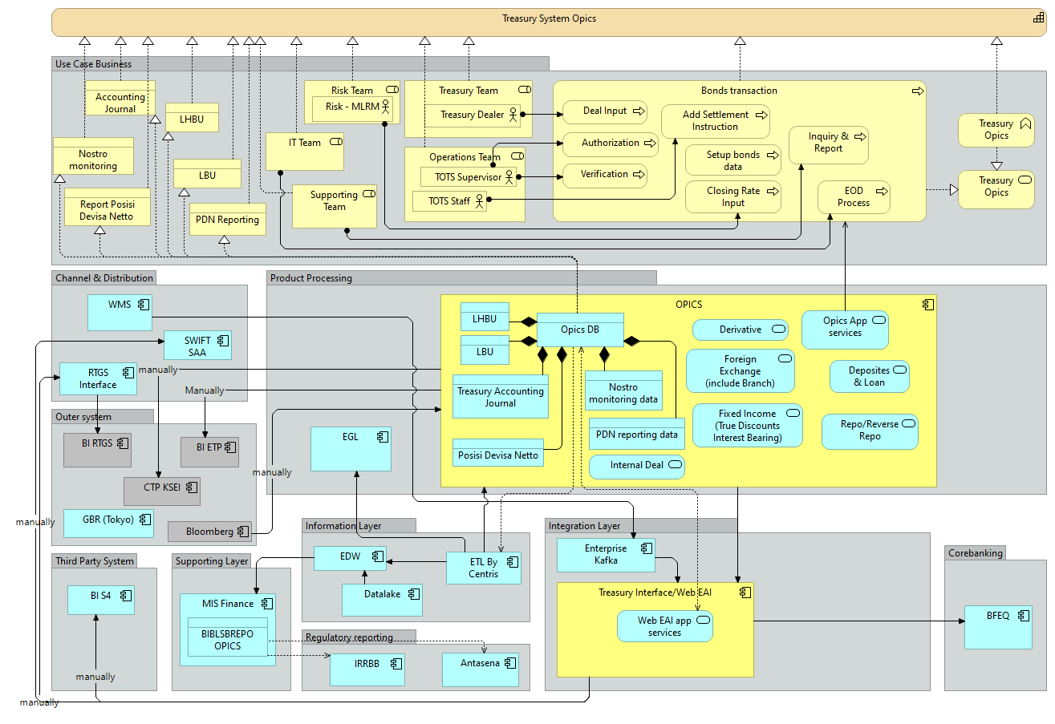
OPICS – TBO Phase 2: Current Architecture Bonds Transaction
Last Update : 26-May -2023
PIC & Contributor : Liston & IT Planning Architect, Project Team
Architecture Highlight
Use Case business: Bond Transaction
Interbank
Bond Transaction
On trade date
On value Date
Receive Coupon and Maturity Bond
Repo Reverse Repo with BI
On Trade Date
Coupon Payment in Repo Period
On Maturity Date
Retail
Bond Transaction
On trade date
On value Date
Receive Coupon and Maturity Bond
Integration Systems: Web Eai
RTGS, BI-S4, BI Reporting, SWIFT: manually
EGL, EDW (MIS Finance, Antasena, IRRBB), BFEQ
WMS→KAFKA→Web Eai
ITSP PORTFOLIO ID: 42
Source: https://jira.btpn.skyfencenet.com/wiki/spaces/DT/pages/3960569884/2023-05-15+OPICS+Termination+TBO+Phase+2

Slide 32
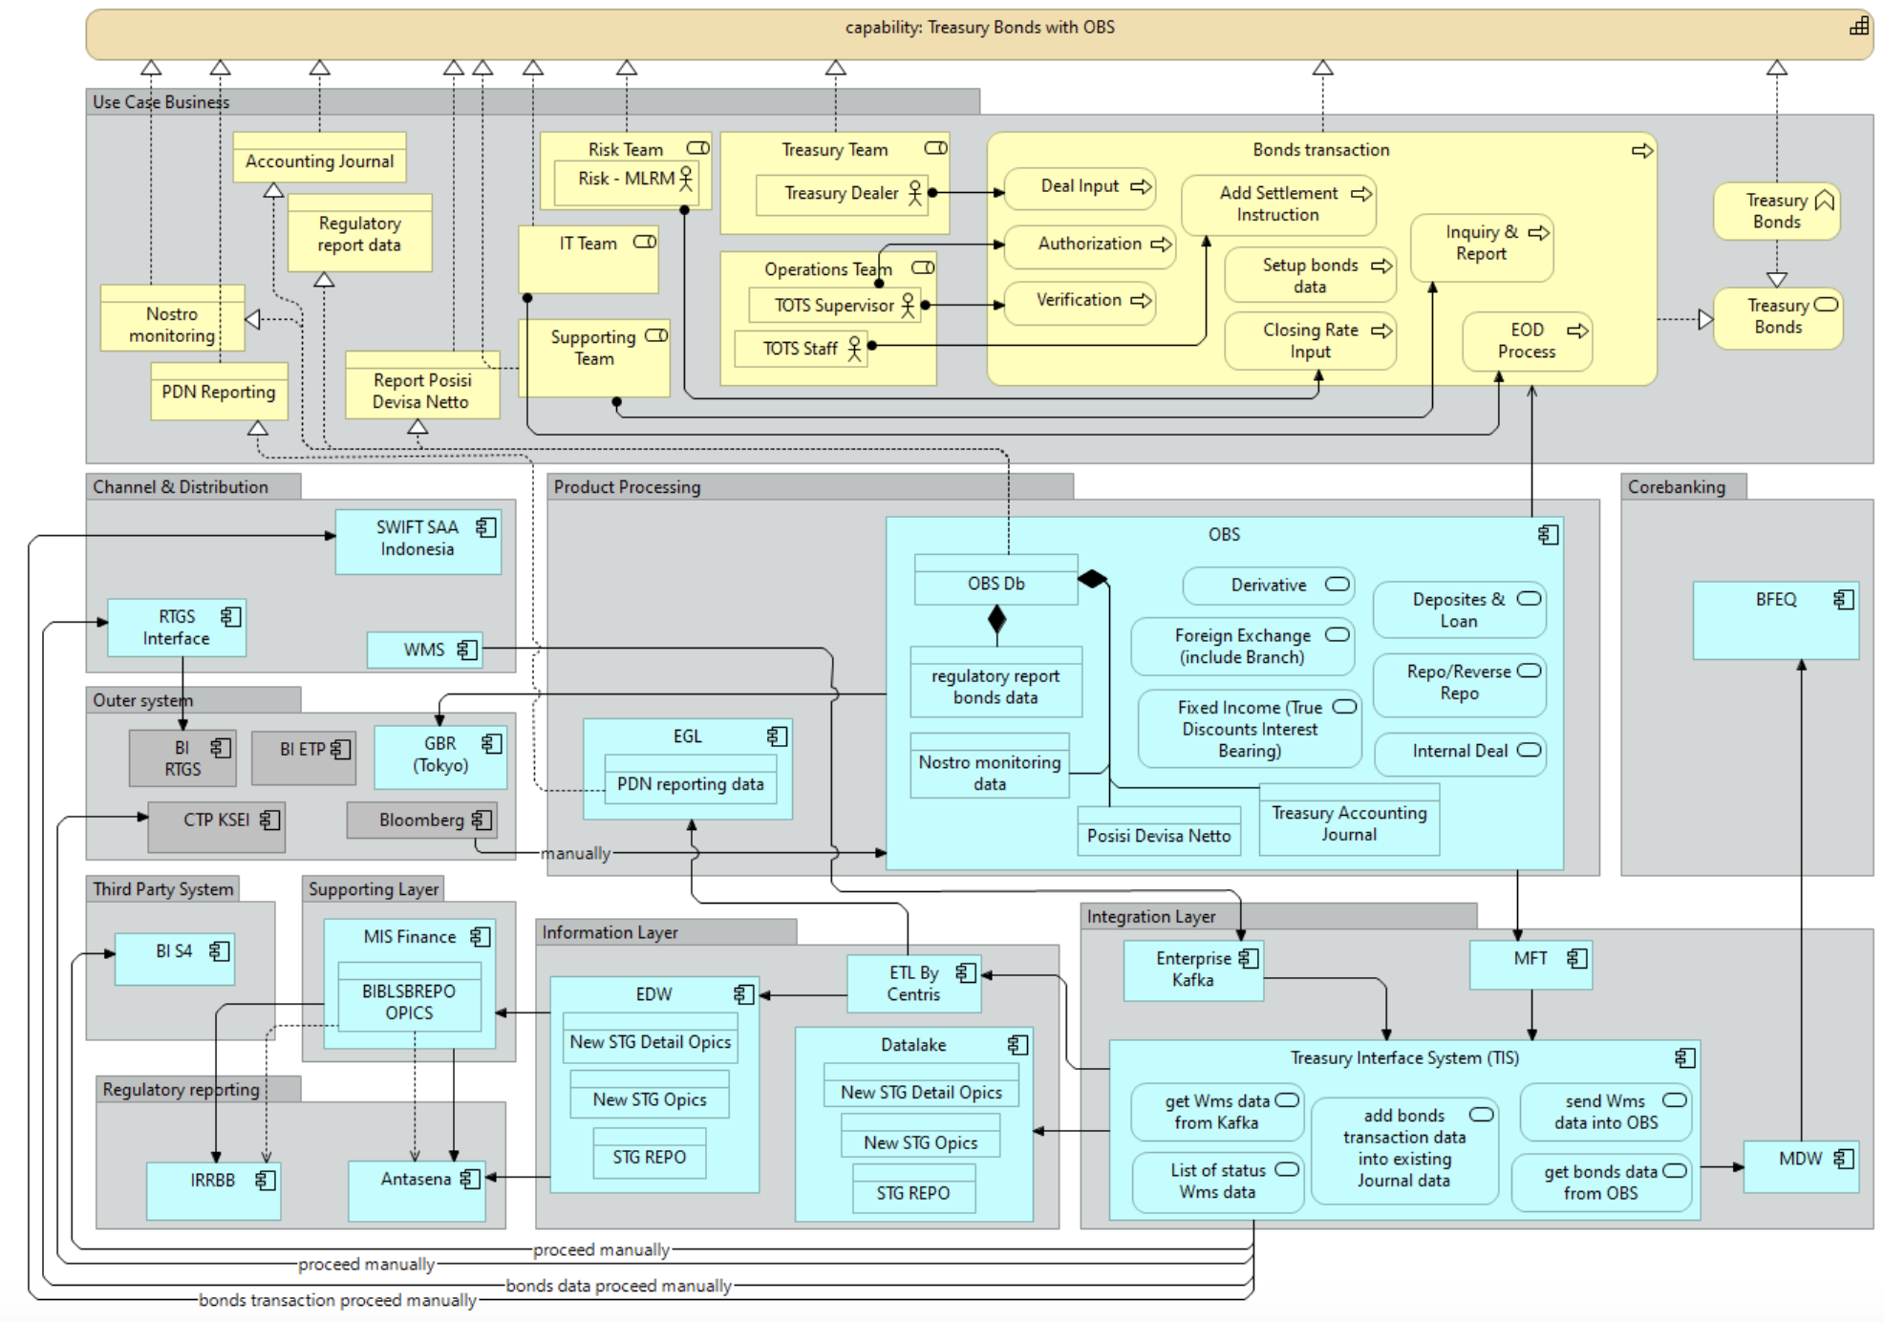
Architecture of Treasury System Consolidation (2/2)
Last Update : 26 May 2023
PIC & Contributor : Liston & IT Planning Architect, Project Team
Architecture Highlight
Use Case business: Bond Transaction
Interbank
Bond Transaction
On trade date
On value Date
Receive Coupon and Maturity Bond
Repo Reverse Repo with BI
On Trade Date
Coupon Payment in Repo Period
On Maturity Date
Retail
Bond Transaction
On trade date
On value Date
Receive Coupon and Maturity Bond
OPICS would be replaced by OBS
Integration Systems: TIS
RTGS, BI-S4, BI Reporting, SWIFT: manually
EGL, EDW (MIS Finance, Antasena, IRRBB), BFEQ
WMS→KAFKA→TIS→OBS
ITSP PORTFOLIO ID: 42
https://jira.btpn.skyfencenet.com/wiki/spaces/DT/pages/3960569884/2023-05-15+OPICS+Termination+TBO+Phase+2

Slide 33
OPICS – TBO PHASE 2: Current Architecture
Last Update : 24 May 2023
PIC & Contributor : Liston & IT Planning Architect, Project Team
Architecture Highlight
OPICS server handle Bond transaction
Bond transaction from WMS would be integrated via KAFKA.
WEB EAI get Wms data from Kafka and send it to OPICS by File.
WEB EAI will send “RECEIVED” status to KAFKA for WMS
WEB EAI provide page for status of received wms data
Regulatory reporting:
TIS provide data to EDW/DATALAKE
Channel & Distribution (Self Service & Assisted)
Integration System
Treasury System
Kafka Enterprise
WMS
Web Eai
OPICS
Core Banking System
Information Layer
Regulatory Reporting
Finance
EDW
MIS Finance
ANTASENA
BFEQ
EGL
IRRBB
OBS:
Input transaction data of retail customer in Bulk by security ID and Price. But it does not proceed in further.
ITSP PORTFOLIO ID: 42

Slide 34
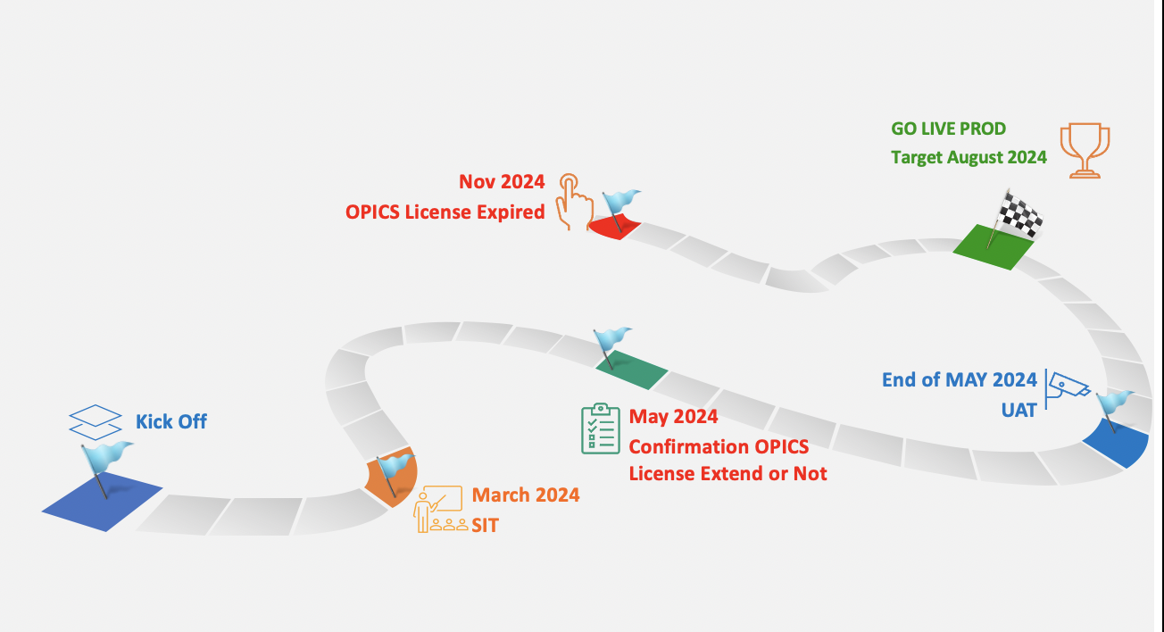
OPICS – TBO PHASE 2: Future Architecture Bonds Transaction
Last Update : 24 May 2023
PIC & Contributor : Liston & IT Planning Architect, Project Team
Architecture Highlight
OBS would be replaced OPICS
Bond transaction from WMS would be integrated via KAFKA.
TIS get Wms data from Kafka and send it to OBS by File.
TIS will send “RECEIVED” status to KAFKA for WMS
TIS provide page for status of received wms data
Regulatory reporting:
TIS provide data to EDW/DATALAKE
Channel & Distribution (Self Service & Assisted)
Integration System
Treasury System
MFT
Kafka Enterprise
TIS
OBS
WMS
IBM MQ
MDW
API GTW
Web Eai
OPICS
Core Banking System
Information Layer
Regulatory Reporting
Finance
OBS & OPICS would not be expected use together due to the complexity on providing data for regulatory
EDW
MIS Finance
ANTASENA
BFEQ
EGL
IRRBB
DATALAKE
ETL CENTRIS
The assessment/discussion is in progress for the requirement planned product and new product.
The assessment result would be added into the scope, and it may or may not impact to the timeline and effort.
As is/no change
Minor changes/configuration
Major changes/enhancement
decommissioned

Slide 35
Payment Consolidation: Current System Architecture Payment
Last Update : 24 May 2023
PIC & Contributor : Liston & Payment consolidation team
Architecture Highlight
Channel & Distribution (Self Service & Assisted)
Mobile Banking/ATM
AKSES BISNIS
BES
SMAR&TS
FES
E-TAX
JENIUS
4
6
7
1
6
4
6
Instruction from Smarts: smarts→Control-M→First
First:
Receives instruction from Smar&ts
validate data→screening→Compliance Link
First→MFT/MDW→BFEQ
SICS: provide standard/special charges for FES and FIRST
Domestic transaction:
Incoming BI-Fast: ATM/Mobile banking→Switching→CI Connector BI-Fast→MDW→BFEQ
SKN/RTGS
E-Tax
SWIFT SAA: incoming transaction from SWIFT
Out going BI-Fast:
FES
Jenius
Akses Bisnis
BES: Proceed BIC Code repair
Auto smarts: decrypt/encrypt file related Smarts
Enterprise Integration
Switching
API Gateway
Middleware
Kafka Enterprise
MFT
Payment & Remittance
Core Banking System
FIRST
BFEQ
2
3
SiCS
MS Payment
Third Party Payment Application
MS Payroll
5
SWIFT SAA
4
Support System
(decrypt/encrypt)
AML/KYC
IF RTGS
IF SKN
SIRON AML
Fircosoft
CI Connector BI-Fast
8
Auto Smarts
Compliance Link

Slide 36
Payment Consolidation: Phase 1 System Architecture (Domestic Payment)
Last Update : 24 May 2023
PIC & Contributor : Liston & Payment consolidation team
Architecture Highlight
Channel & Distribution (Self Service & Assisted)
Mobile Banking/ATM
AKSES BISNIS
BES
SMAR&TS
FES
E-TAX
JENIUS
4
6
7
1
6
4
6
Instruction from Smarts: smar&ts → MFT→MS Payment (domestic payment)
MS Payment:
Receives instruction from Smar&ts
validate data→screening→Compliance Link
First→MFT/MDW→BFEQ
SICS: Provide standard/special charges for FES, FIRST and MS Payment. Add integration to MS Payment
Domestic transaction:
Incoming BI-Fast: ATM/Mobile banking→Switching→CI Connector BI-Fast→MDW→BFEQ
SKN/RTGS
E-Tax
SWIFT SAA: incoming transaction from SWIFT
Out going BI-Fast:
FES
Jenius
Akses Bisnis
BES: Proceed BIC Code repair
Auto smarts: decrypt/encrypt file related Smar&ts
Status: In progress Assessment
Enterprise Integration
Switching
API Gateway
Middleware
Kafka Enterprise
MFT
Payment & Remittance
Core Banking System
FIRST
BFEQ
SiCS
3
MS Payment
Third Party Payment Application
MS Payroll
2
5
SWIFT SAA
4
Support System
(decrypt/encrypt)
AML/KYC
IF RTGS
IF SKN
SIRON AML
Fircosoft
CI Connector BI-Fast
8
Auto Smarts
Compliance Link
As is/no change
Minor changes/configuration
Major changes/enhancement

Slide 37
Doka-NG – Trade Finance PHASE 2: Current Architecture
Last Update : 24 May 2023
PIC & Contributor : Liston & IT Planning Architect, Project Team
Architecture Highlight
Datalake provide data of CIF & Account (delta) for Doka-NG via MFT
CIF Dummy of Doka-Ng does not flow to Regulatory reporting.
The Internal Reporting for Trade Finance saved in the Storage Server (NAS)
ITSP PORTFOLIO ID: 139
Trade Finance
Integration System
Channel & Distribution (Self Service & Assisted)
MFT
MDW
API GTW
Doka-Ng
SWIFT
RTGS
MS Common
Kafka Enterprise
Control-M
SKN
SiCS
Supporting System
Information Layer
Regulatory Reporting
Core Banking System
BG AJO
DATALAKE
ANTASENA INTRADAY
ANTASENA
BFEQ
EDW
ETL
Regla – SLIK Corporate
IRRBB
LPS
IRRS - LLD
Finance
COMANDOS
AML FEEDER
IRRS - LLL
IFRS 9
EGL
As is/no change
Minor changes/configuration
Major changes/enhancement
Reference: https://jira.btpn.skyfencenet.com/wiki/spaces/DT/pages/3962667011/2023-05-19+Doka-Ng+Phase+2

Slide 38
Doka-NG – Trade Finance PHASE 2: Future Architecture
Last Update : 24 May 2023
PIC & Contributor : Liston & IT Planning Architect, Project Team
Architecture Highlight
BFEQ will create file for data of CIF & Account (delta) for Doka-NG via MFT
BFEQ add flag/entry for CIF Dummy of Doka-Ng and it will flow to EDW for Regulatory reporting.
The Internal Reporting for Trade Finance saved in the separated server
ITSP PORTFOLIO ID: 139
Target GO LIVE: End of September 2023
Trade Finance
Integration System
Channel & Distribution (Self Service & Assisted)
MFT
MDW
API GTW
Doka-Ng
SWIFT
RTGS
MS Common
Kafka Enterprise
Control-M
SKN
SiCS
Supporting System
Information Layer
Regulatory Reporting
Core Banking System
BG AJO
DATALAKE
ANTASENA INTRADAY
ANTASENA
BFEQ
EDW
ETL
Regla – SLIK Corporate
IRRBB
Trade Finance Internal Reporting Server
IRRS - LLD
Finance
COMANDOS
LPS
AML FEEDER
IRRS - LLL
IFRS 9
EGL
As is/no change
Minor changes/configuration
Major changes/enhancement
New Application
Reference: https://jira.btpn.skyfencenet.com/wiki/spaces/DT/pages/3962667011/2023-05-19+Doka-Ng+Phase+2

Slide 39
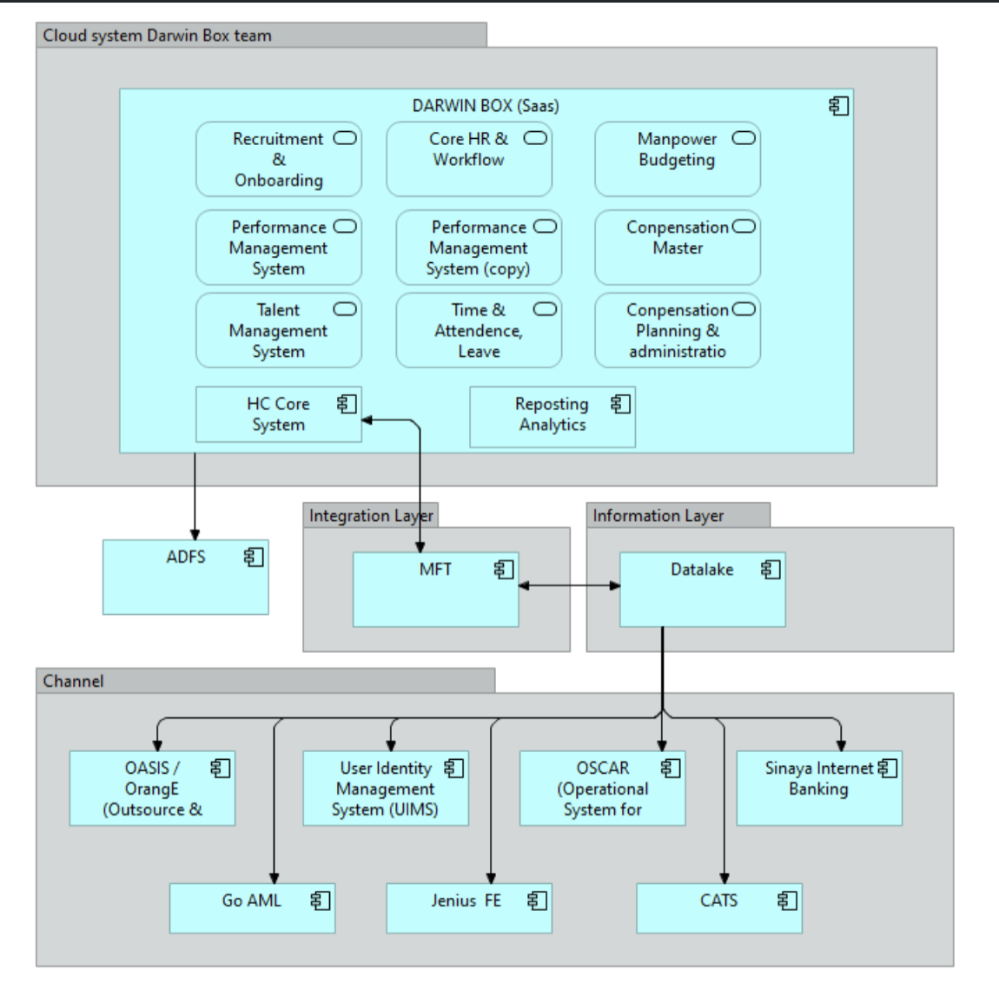
Architecture of Neo HC Transformation
Last Update :
PIC & Contributor :
Architecture Highlight
ss

Slide 40
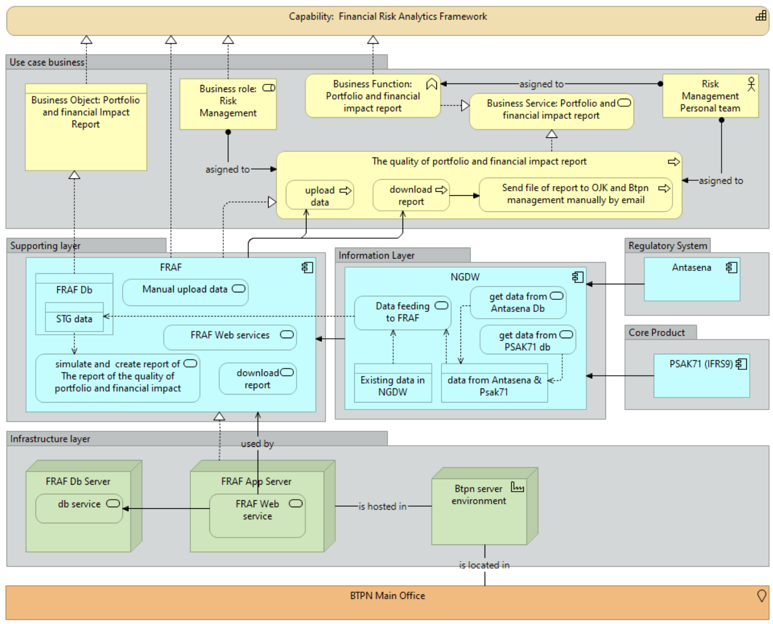
Architecture of FRAF
Last Update :
PIC & Contributor :
Architecture Highlight
Project currently still on vendor pitching phase with multiple candidates.
FRAF will served as main processor and generator of report related to portfolio and financial impact.
Infrastructure planned to be on premise on BTPN environment.
ITSP PORTFOLIO ID: 20
https://jira.btpn.skyfencenet.com/wiki/spaces/DT/pages/3893134298/2023-02-13+Financial+Risk+Analytics+Framework+FRAF
https://jira.btpn.skyfencenet.com/wiki/spaces/DT/pages/3893134298/2023-02-13+Financial+Risk+Analytics+Framework+FRAF

Slide 41
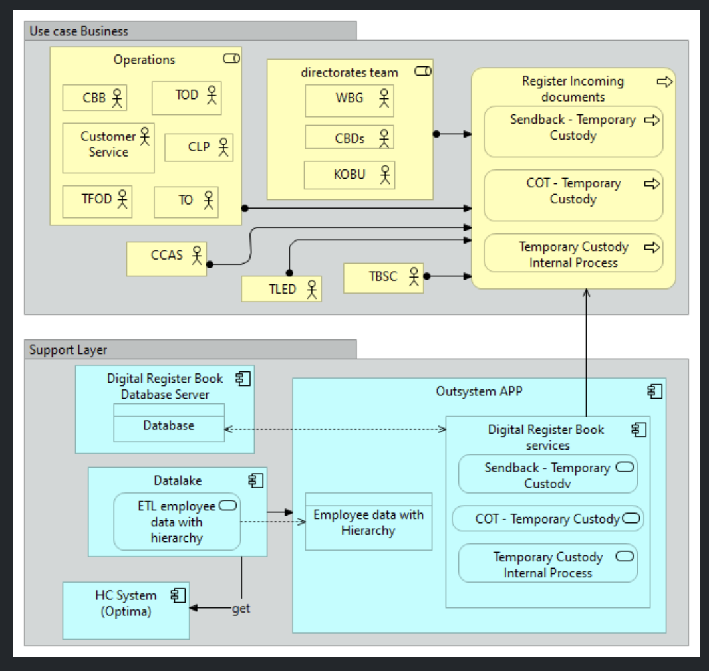
Architecture of Digitalization of Register Book
Last Update :
PIC & Contributor :
Architecture Highlight

Slide 42
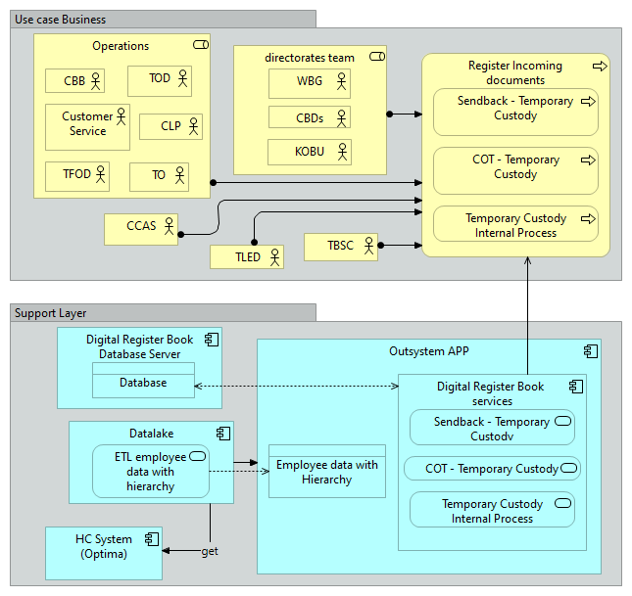
Architecture of Digitalization of Register Book
Last Update :
PIC & Contributor :
Architecture Highlight
2023-03-02: Digital Register Book - Digital Transformation - Confluence (skyfencenet.com)

Slide 43
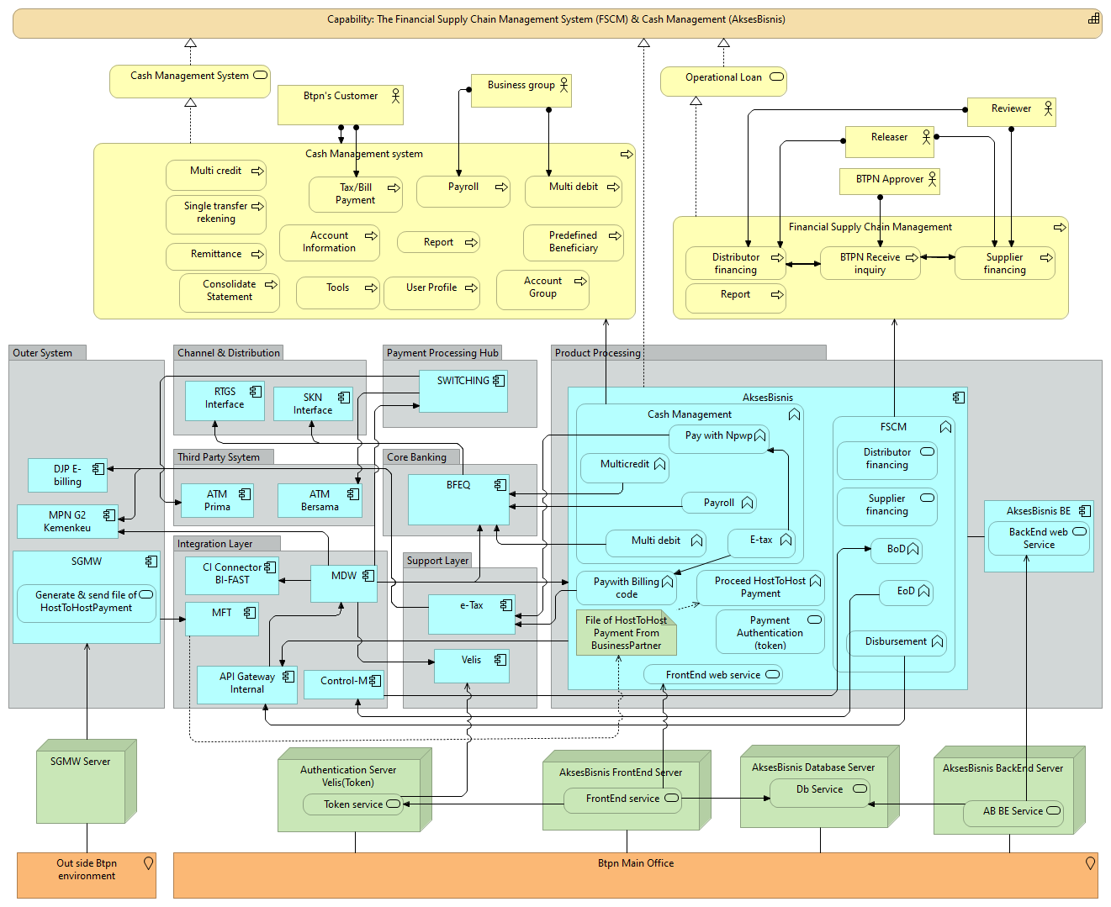
Architecture of Trade Finance System Phase 2 : FE System for trade & Supply Chain
Last Update :
PIC & Contributor :
Architecture Highlight

Slide 44
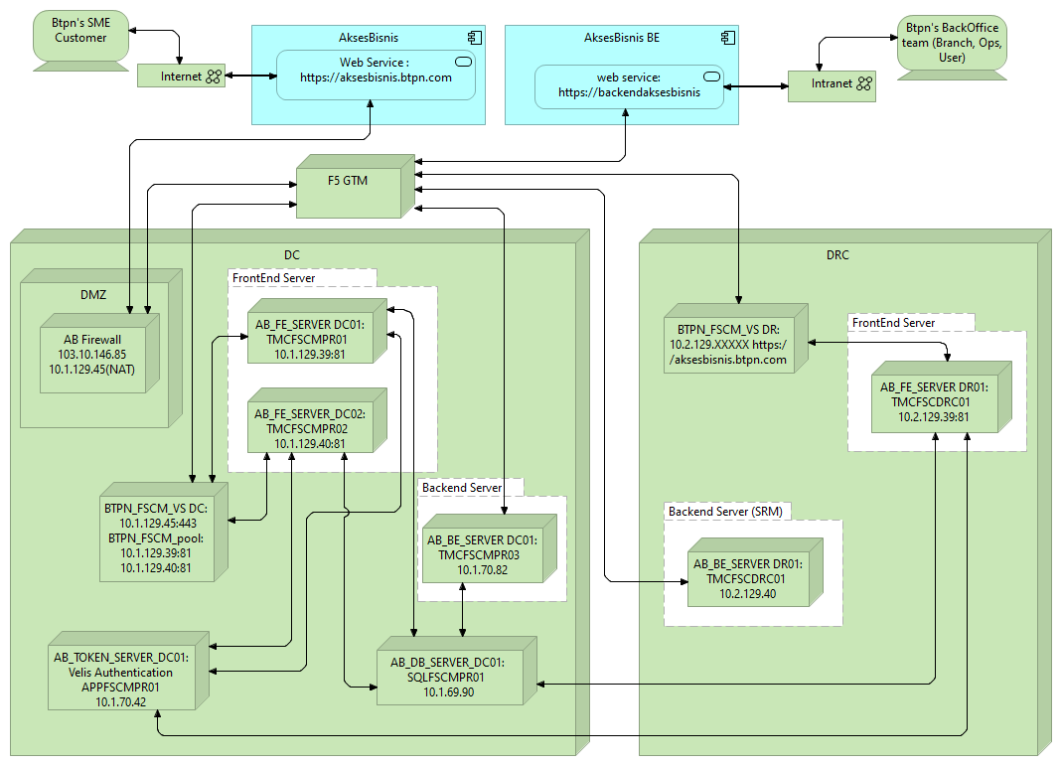
Architecture of Trade Finance System Phase 2 : FE System for trade & Supply Chain
Last Update :
PIC & Contributor :
Architecture Highlight

